Slide 1
Genome Assembly and Annotation of S.multivorum
By Adam Musleh and Shray Komal

Slide 2
Contents of PowerPoint
Background Information
Genome assembly:
Quality assessment
Quality Trimming and Cleanup
Error correction and assemblies
Assemblies' comparison using Spades/Megahit
Annotation:
Approach 1: RASTtk
Approach 2: PROKKA
Filtering protein of interest by MUSCLE and HMMER
3D structure analysis of specific protein Carbohydrate-Active Enzymes.
Phylogenetic tree analysis

Slide 3
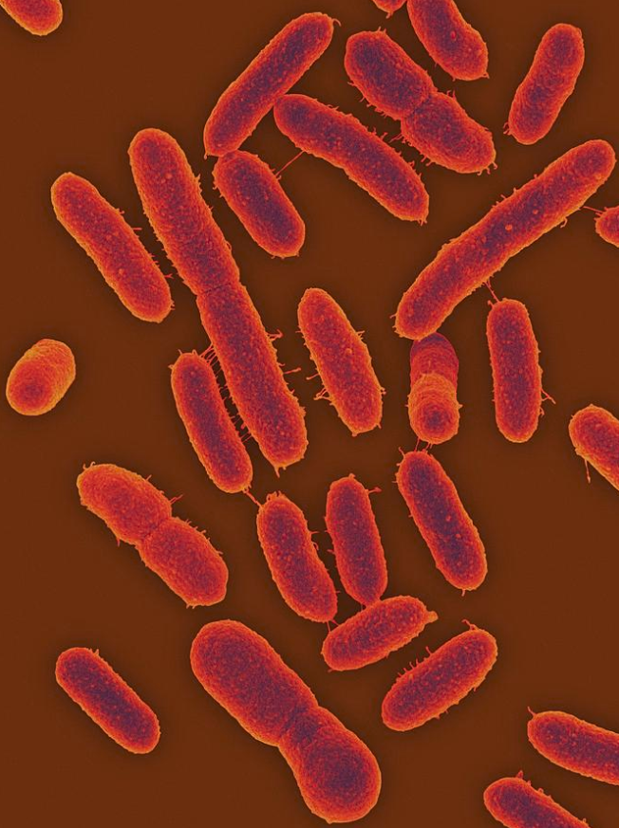
Background Information
Sphingobacterium multivorum is a rod-shaped and non-spore forming bacteria
The bacteria do rarely cause disease in humans and are found in urine and blood
They are naturally resistant to many commonly used antibiotics and antiseptics/disinfectants
It is a gram-negative, non-fermentative and catalase-producer
The optimal growth temperate of the bacterium is 26 °C
https://pixels.com/featured/sphingobacterium-psychroaquaticum-dennis-kunkel-microscopyscience-photo-library.html

Slide 4
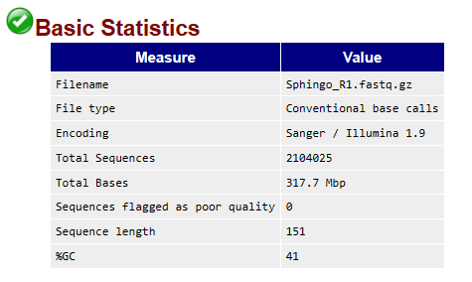
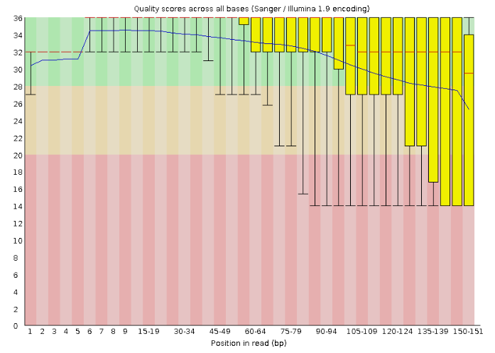
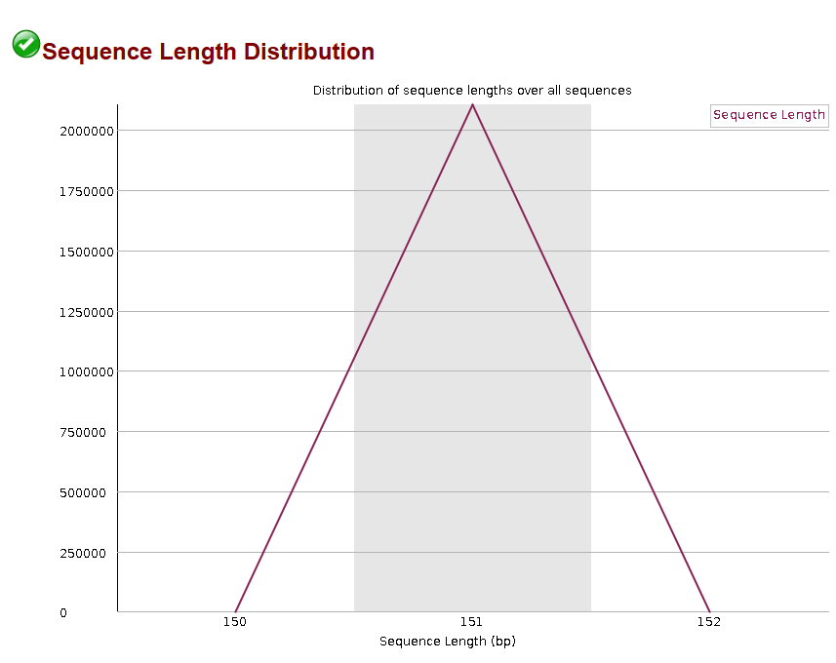
Pre-trim Quality Assessment

Slide 5
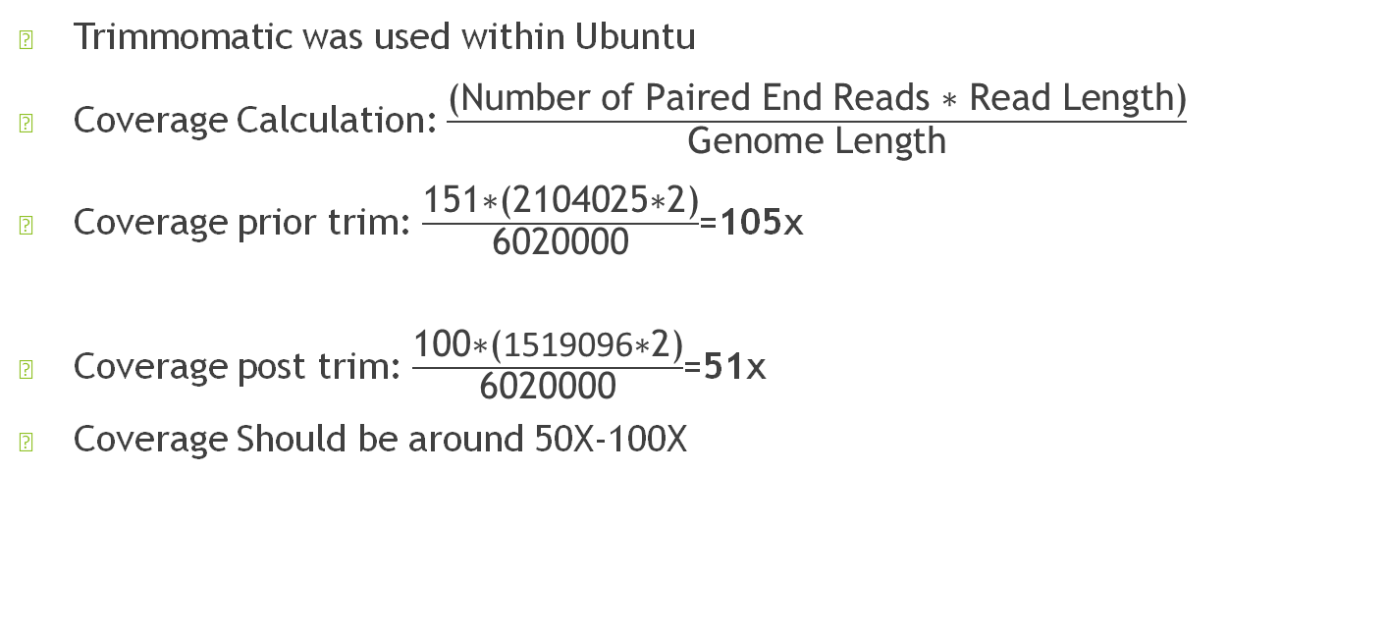
Quality Trimming and Clean up
Trimmomatic was used within Ubuntu
Coverage Calculation: $\frac{\text{(}\text{Number} \text{of} \text{Paired} \text{End} \text{Reads}\text{ ∗ }\text{Read} \text{Length}\text{)}}{\text{Genome} \text{Length}}$
Coverage prior trim: $\frac{\text{151∗(2104025∗2}\text{)}}{\text{6020000}}$=105x
Coverage post trim: $\frac{\text{1}\text{00}\text{∗(}\text{1519096}\text{∗2}\text{)}}{\text{6020000}}$=51x
Coverage Should be around 50X-100X

Slide 6
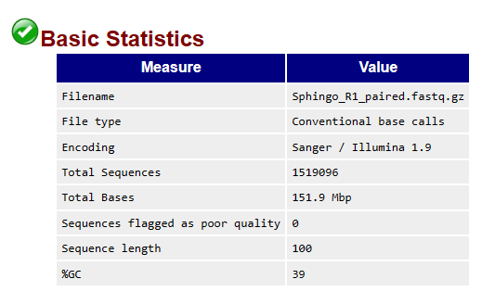
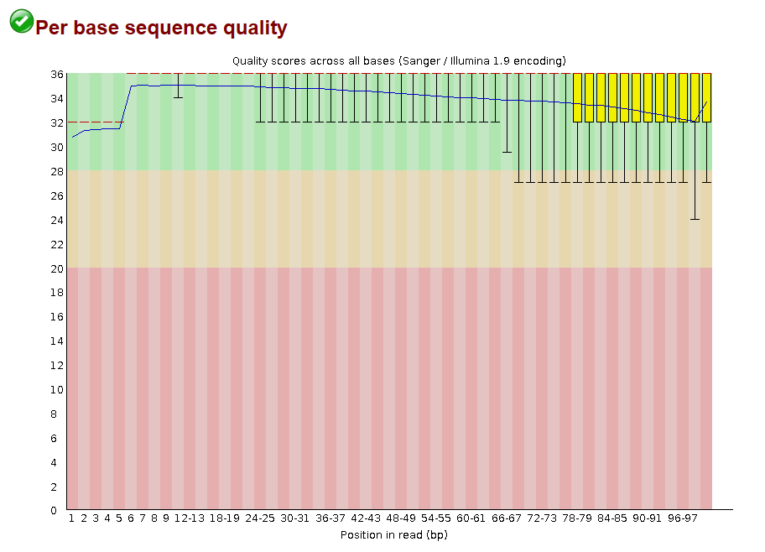
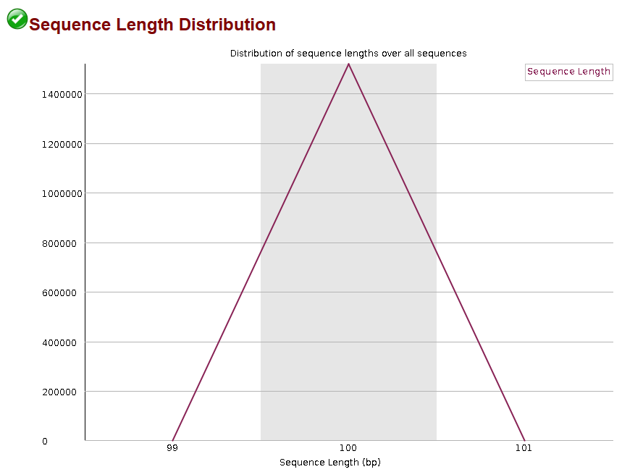
Post-Trim Quality Assessment
Information: ● Only sequences with length of 125 are included ● Trimming details: CROP:125 LEADING:10 TRAILING:15 SLIDINGWINDOW:1:10 MINLEN:125

Slide 7
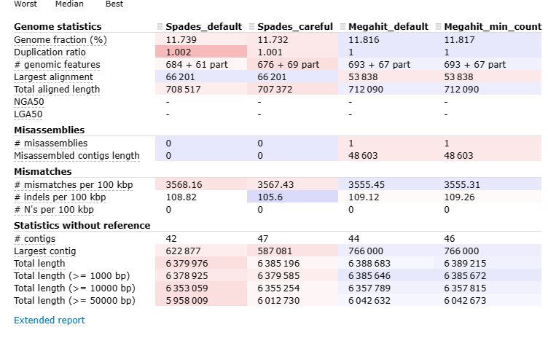
Assembly Comparison using Spades/Megahit

Slide 8
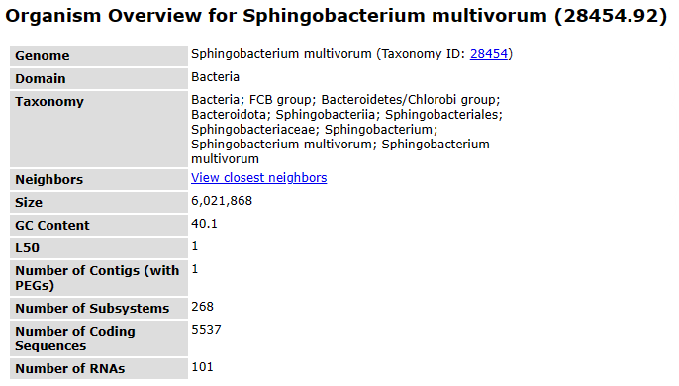
Genome Summary - RASTtk
Genome Size: 6,021,868 ❖ #of Coding Sequences (CDS): 5,537 ❖ GC Content: 40.1% ❖ Number of RNAs: 101 ❖ Number of Hypothetical Proteins: 865 ❖ Antibiotic Resistance Proteins: 18 ❖ Secondary Metabolism: 5

Slide 9
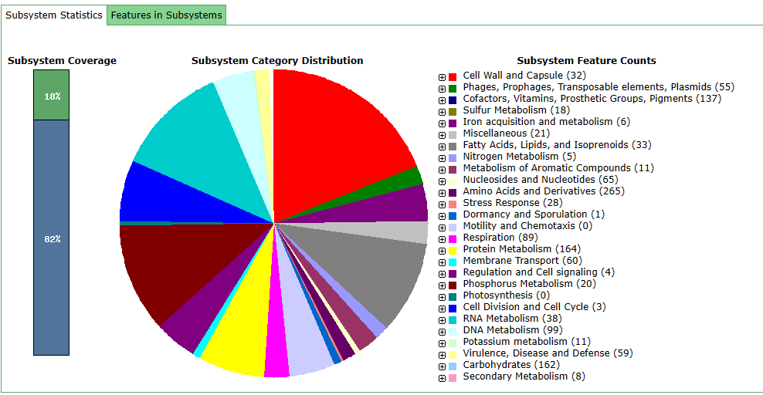
Genome Annotation with RASTtk

Slide 10
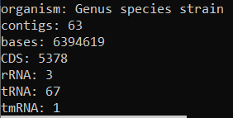
Genome Summary: Prokka
Genome Size: 6,394,619 ❖ #of Coding Sequences (CDS): 5,378 ❖ GC Content: 69.5% ❖ Number of RNAs: 71 ❖ Number of Hypothetical Proteins: 131

Slide 11
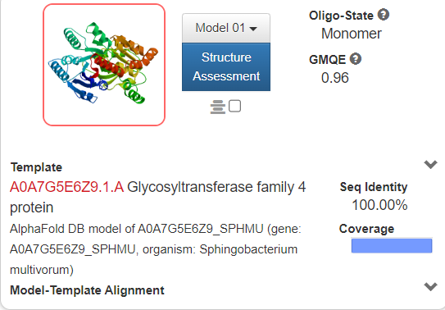
Protein of Interest: Glycosyltransferase
Use the previous genome assembly from megahit
prokka>> prokka --outdir . --force --kingdom Bacteria --proteins GCF_016725865.1_ASM1672586v1_protein.faa final.contigs.fa>> downloaded the protein bank for organism
Protein annotation was downloaded from the swissprot database
Prokka was ran for annotation
Results were displayed

Slide 12
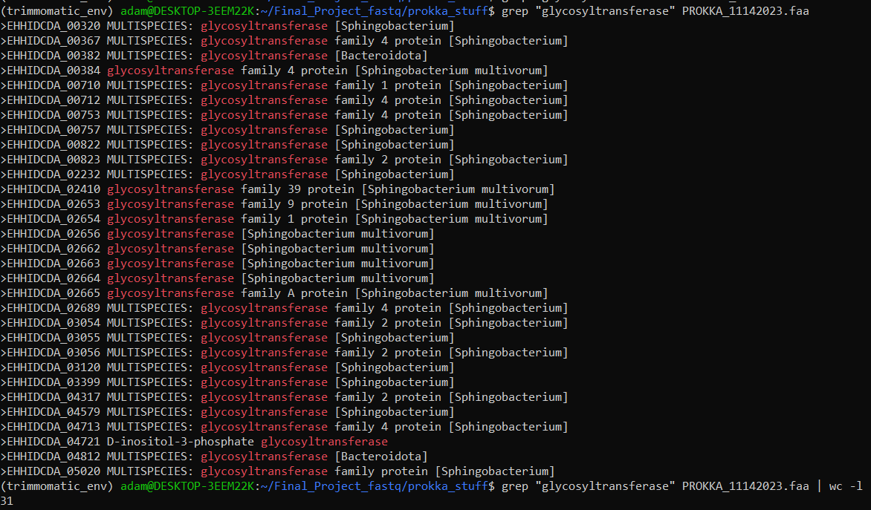
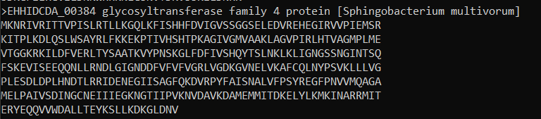
Results

Slide 13
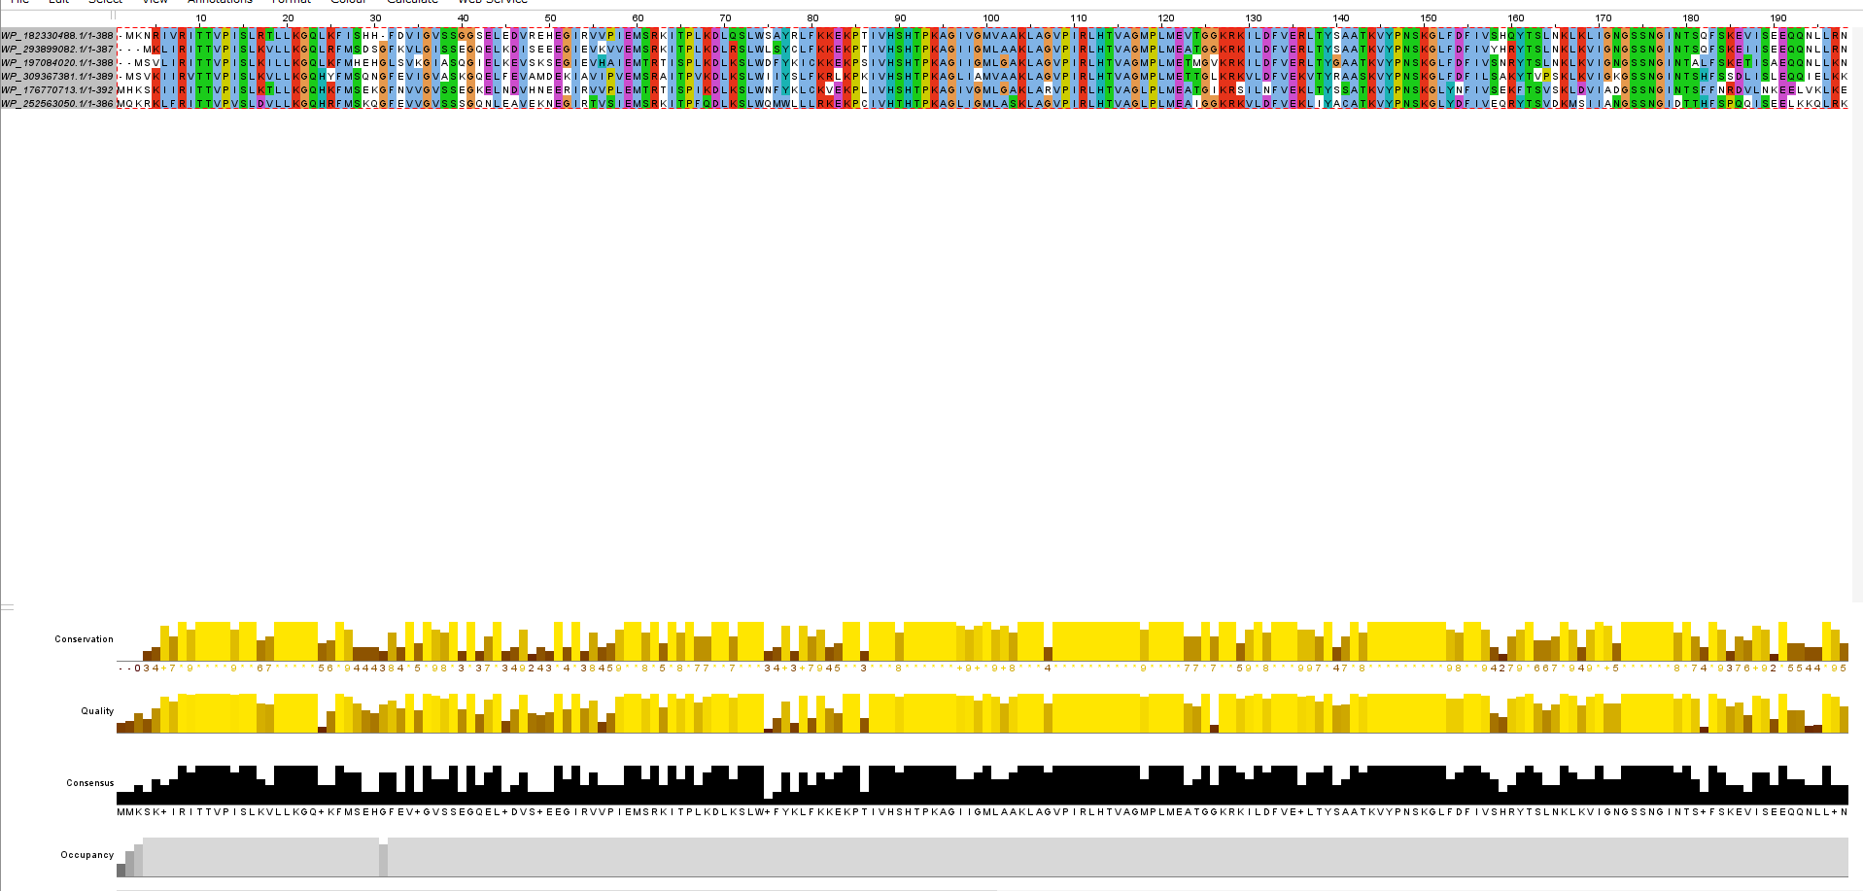
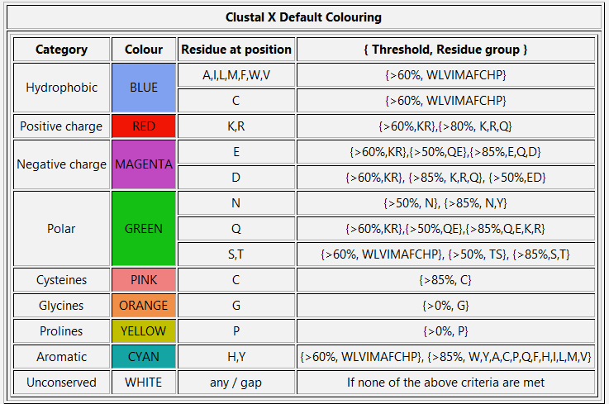
Protein Analysis-Jalview

Slide 14
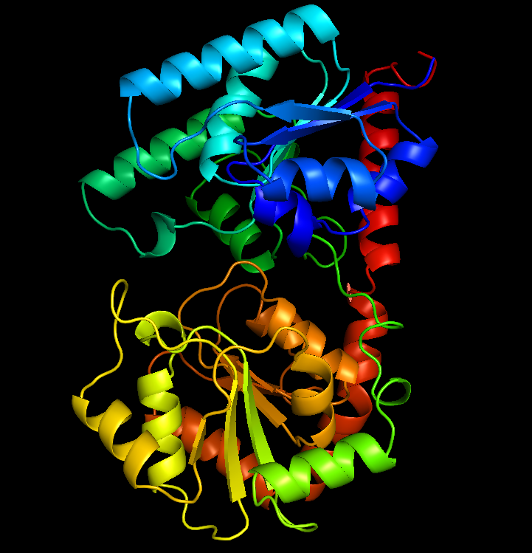
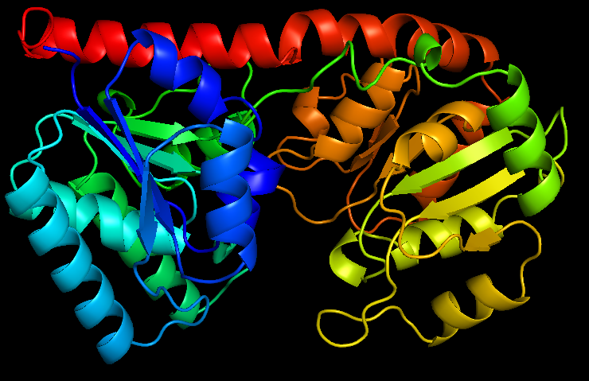
3D structure Analysis-Pymol (pretty filter)

Slide 15
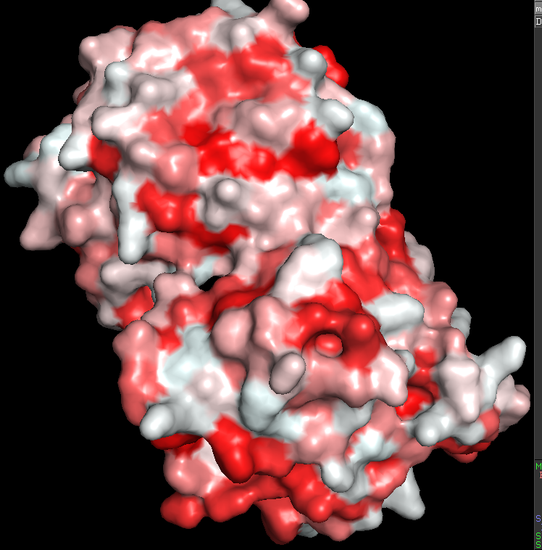
3D Structure Visualization-Pymol (color h)

Slide 16
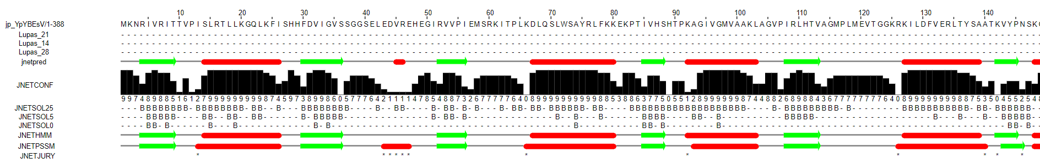
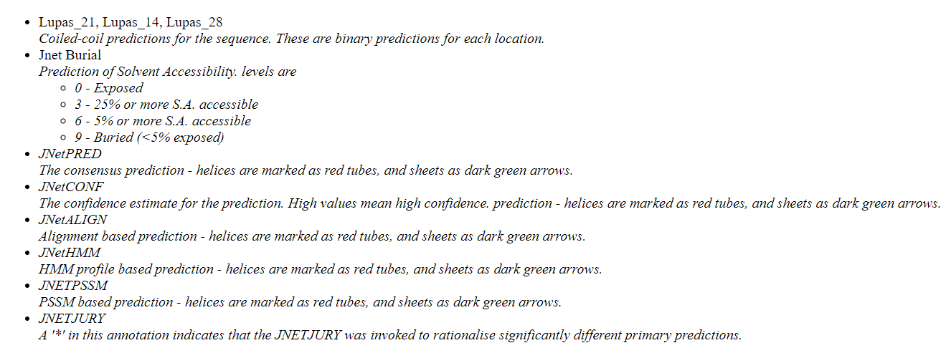
Protein Analysis-Jpred

Slide 17
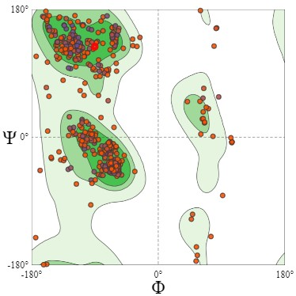
Protein Visualization-Ramachandra Plot

Slide 18
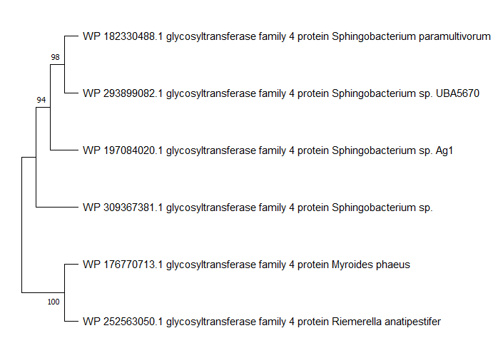
Phylogenetic Tree

